Slide 1
INFOTRIXS ClOUD AWS PROJECT
Title: Implementing File Storage with Amazon EFS
Team Name: Cloud 08
Team Members : Bibi Ayesha Bagali
Ankumpeta Vimala
Kshitij Ashirwad Kambli

Slide 2
CONTENTS
Introduction
System Requirements
EC2 Instances
Mounting and Access Permissions
Scalability and Elasticity
Testing and Validation
Conclusion
Resources and References

Slide 3
Introduction INTRODUCTION
Create a scalable and shared file storage system using Amazon Elastic File System (EFS). Implementation: Set up an EFS file system, mount it to EC2 instances, and configure access permissions. Use it to share files across multiple instances.

Slide 4
System Requirements
EFS File System Setup:
Provision an Amazon EFS file system within the desired AWS region.
Define the appropriate storage capacity based on the expected file system usage and growth.
Configure the EFS file system to utilize the desired availability zones to ensure high availability and durability.
Enable file system encryption for data security.
Determine the performance mode (general purpose or Max I/O) based on workload requirements.
Establish file system lifecycle policies for automated data management.

Slide 5
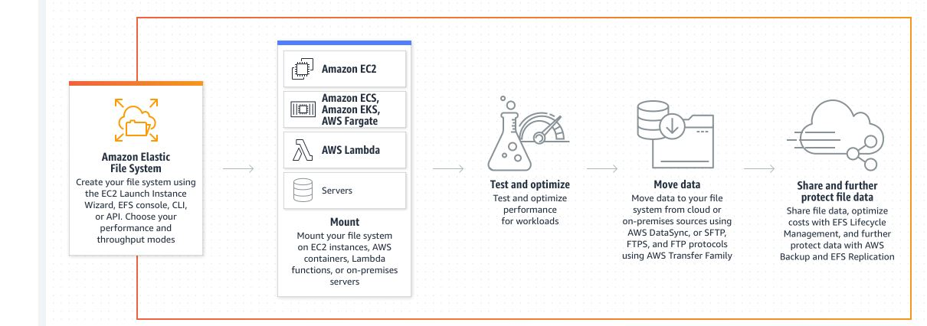
EFS Architecture

Slide 6
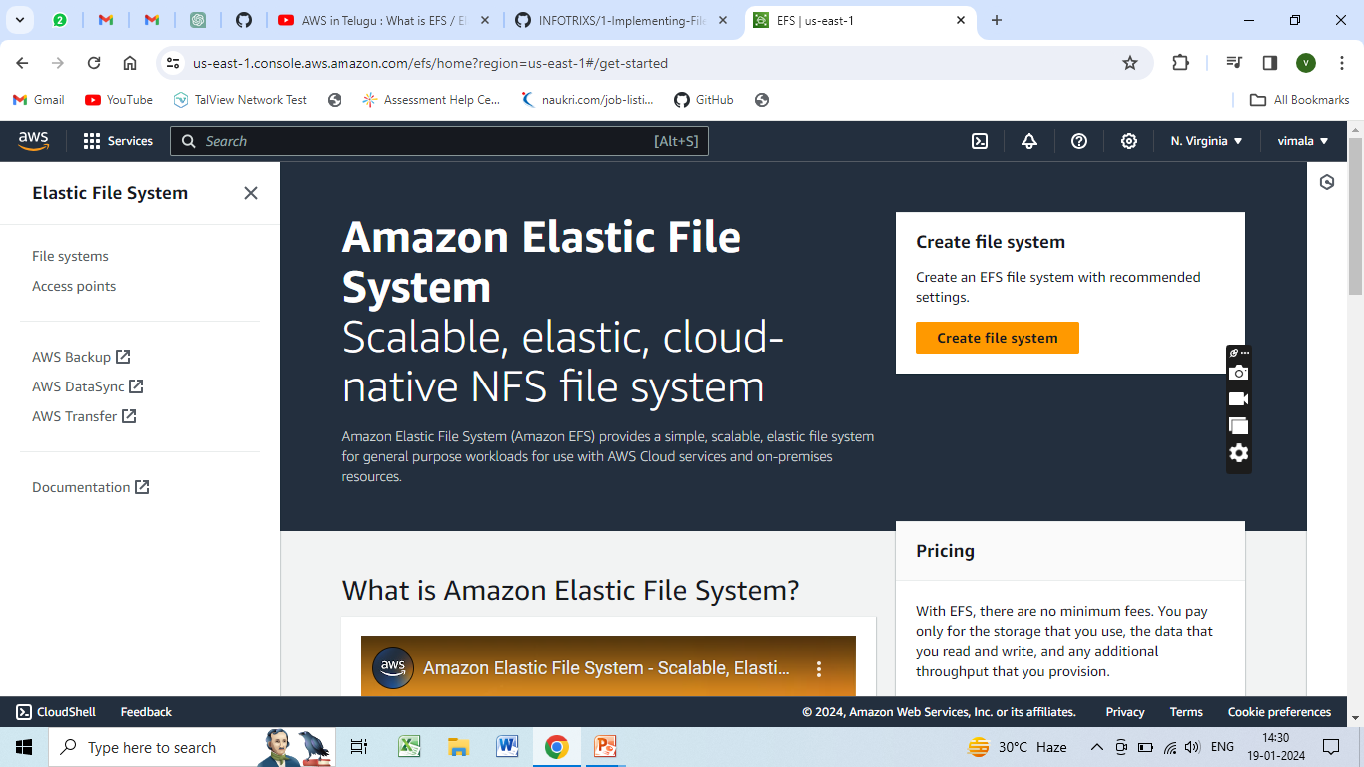
Provision an Amazon EFS file system within the desired AWS region.

Slide 7
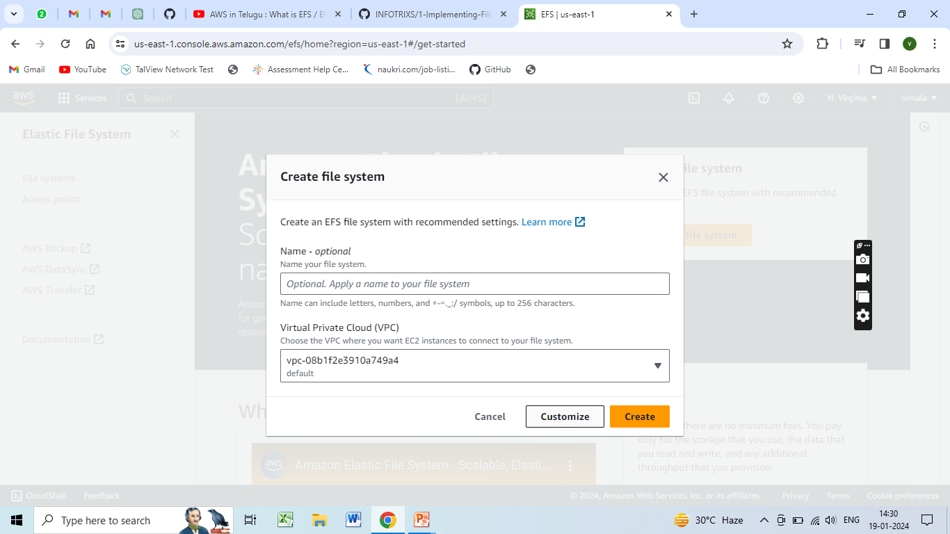

Slide 8
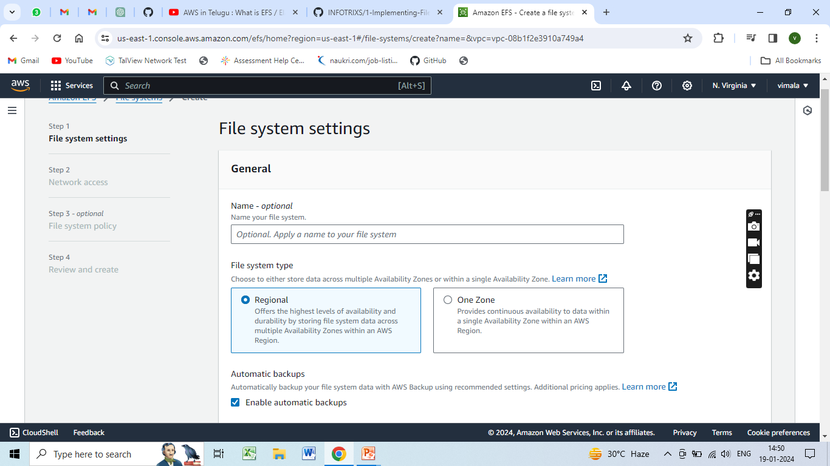
Configure the EFS file system to utilize the desired availability zones to ensure high availability and durability.

Slide 9
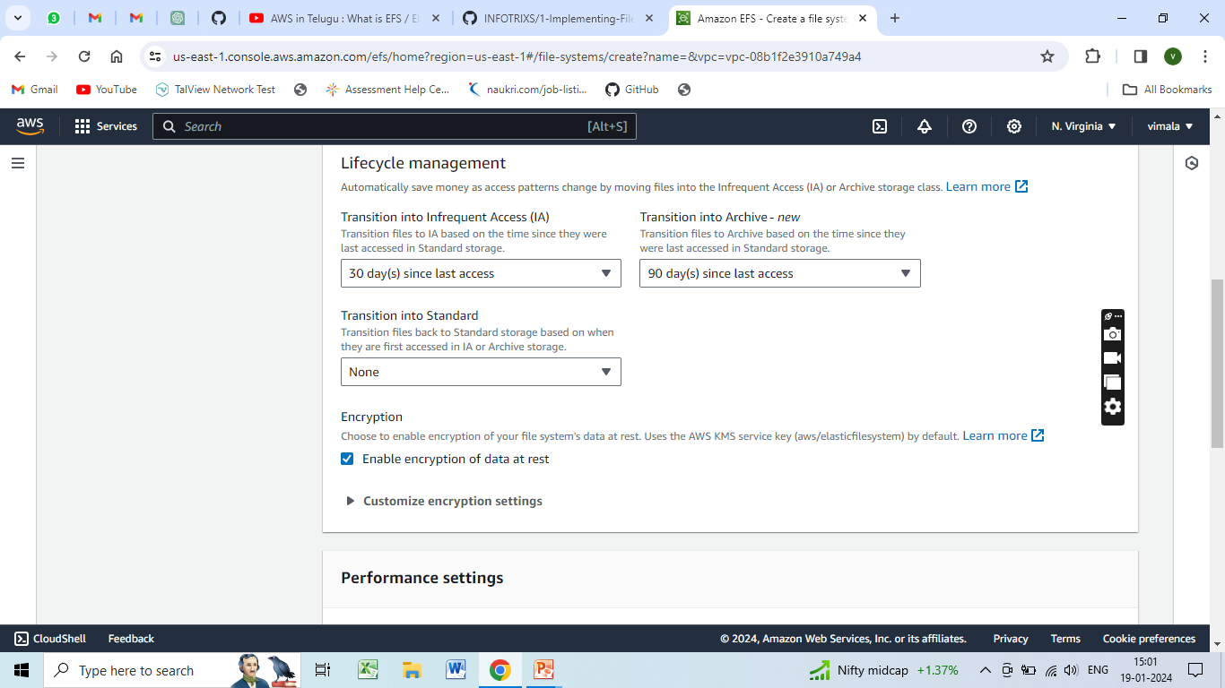
Define the appropriate storage capacity based on the expected file system usage and growth.

Slide 10
Enable file system encryption for data security.

Slide 11
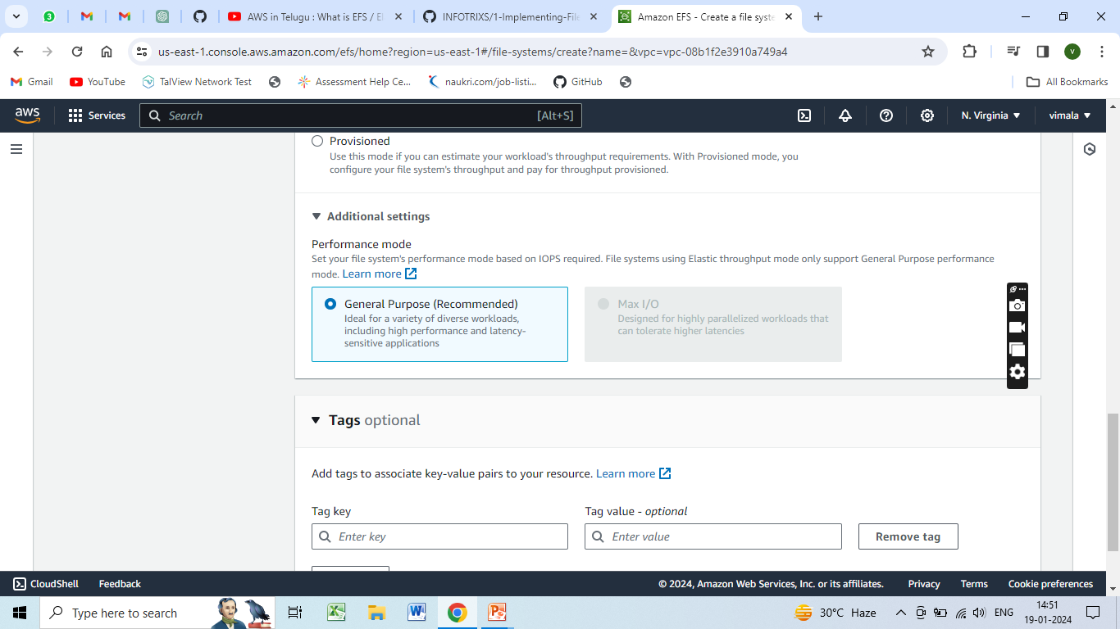
Determine the performance mode (general purpose or Max I/O) based on workload requirements.

Slide 12
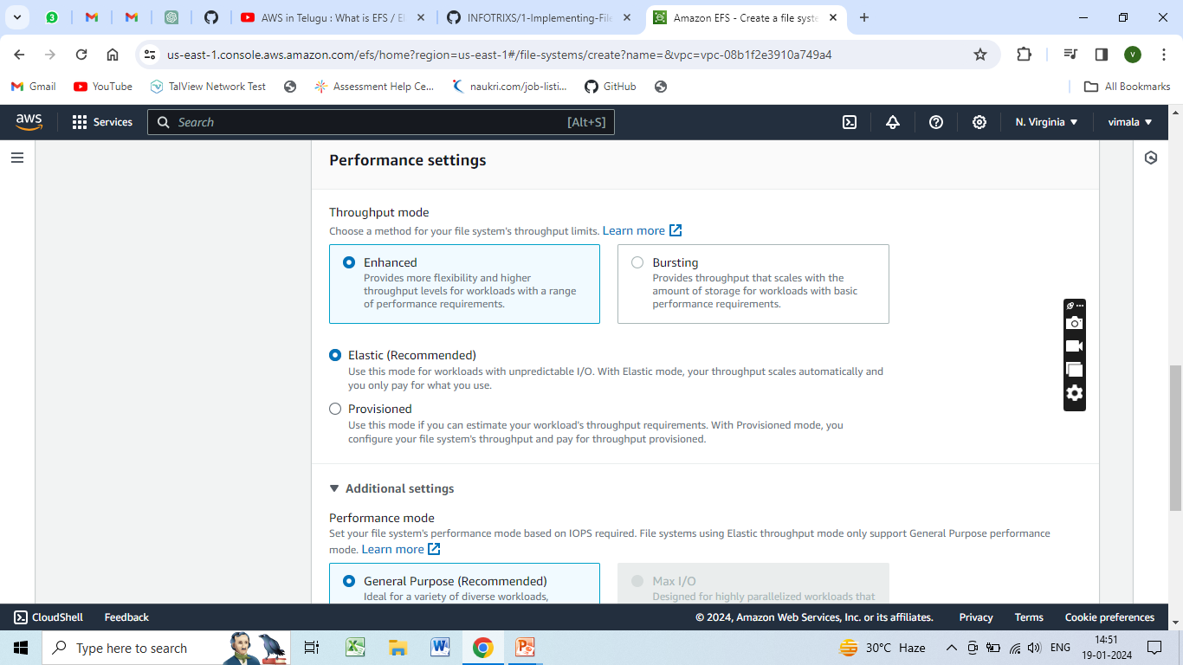
Establish file system lifecycle policies for automated data management.

Slide 13
EC2 Instances
Launch and configure one or more EC2 instances within the same VPC as the EFS file system.
Establish proper network connectivity and security settings between the EC2 instances and the EFS file system.
Ensure that the EC2 instances have the necessary permissions to access the EFS file system.
Implement appropriate instance types and sizes based on the workload demands.

Slide 14
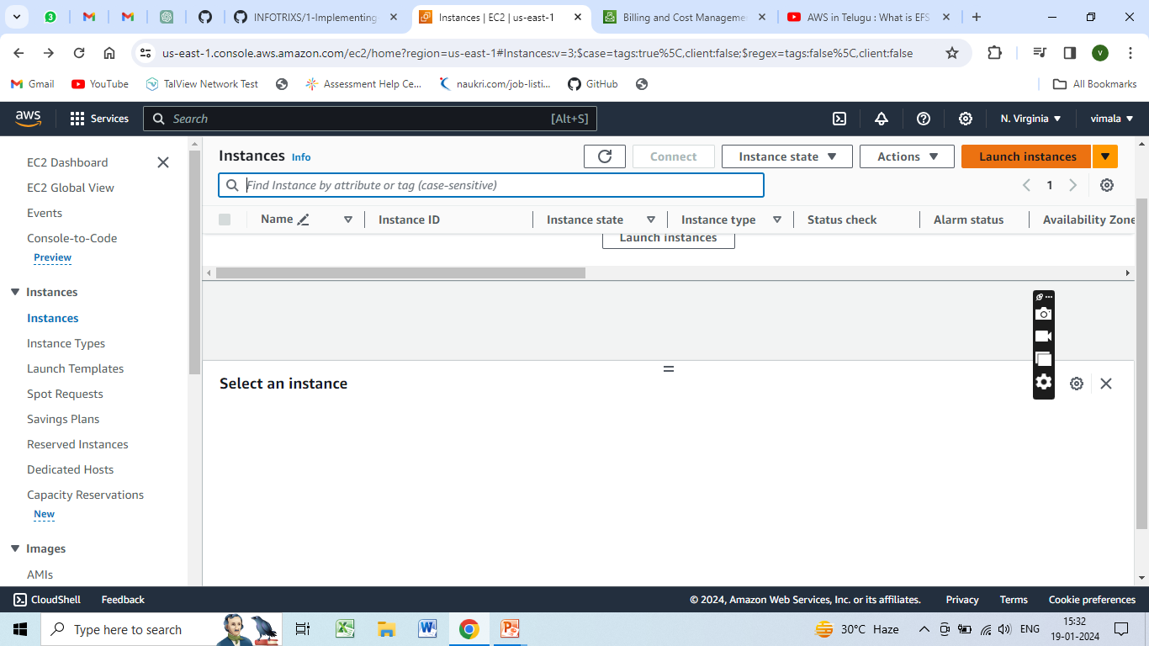

Slide 15
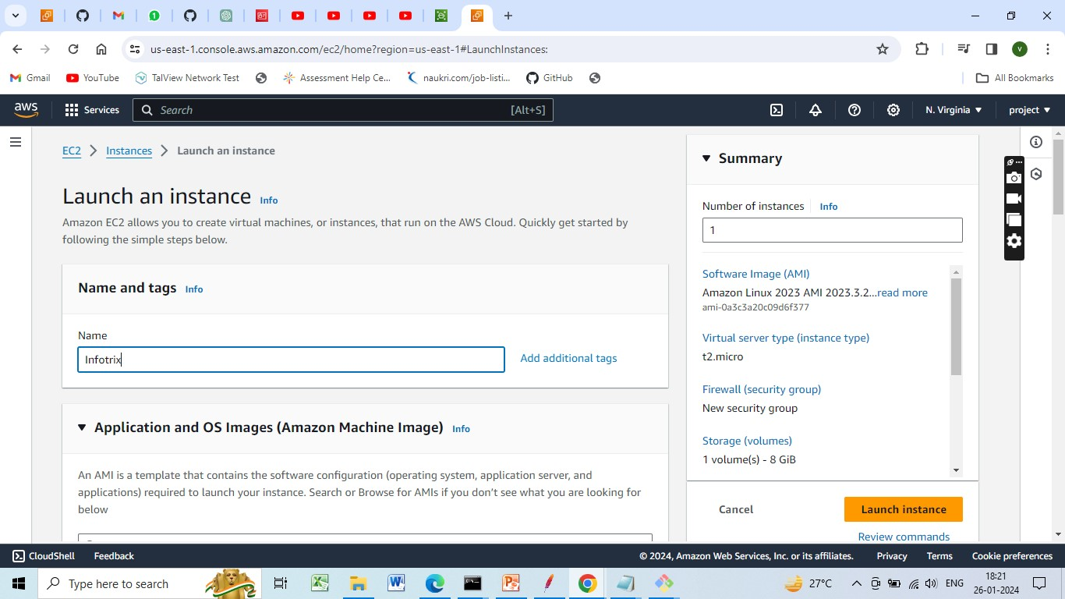
Creating an Amazon EC2 instance

Slide 16
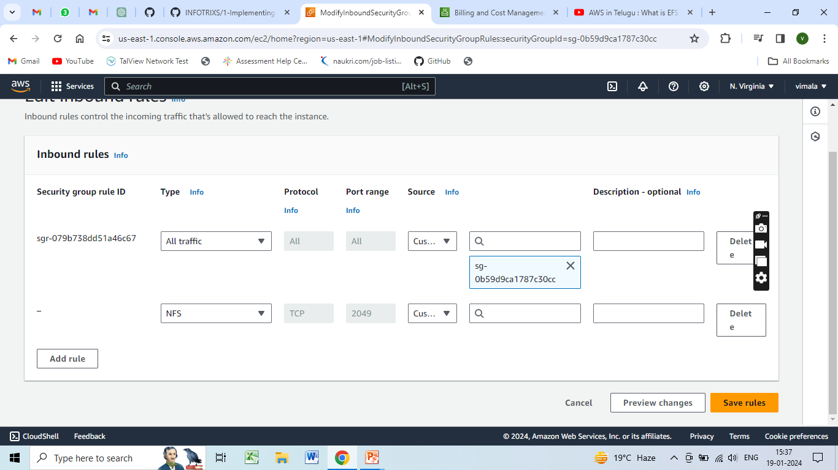
Security group with NFS -2049

Slide 17
Mounting and Access Permissions
Mount the EFS file system onto the EC2 instances using the necessary mount targets.
Implement a consistent and reliable method for mounting the file system during instance boot-up.
Configure access permissions to enable proper file sharing and collaboration.
Define user-level access controls and roles to manage read, write, and execute permissions for files and directories.
Implement security best practices to restrict unauthorized access to the file system.

Slide 18
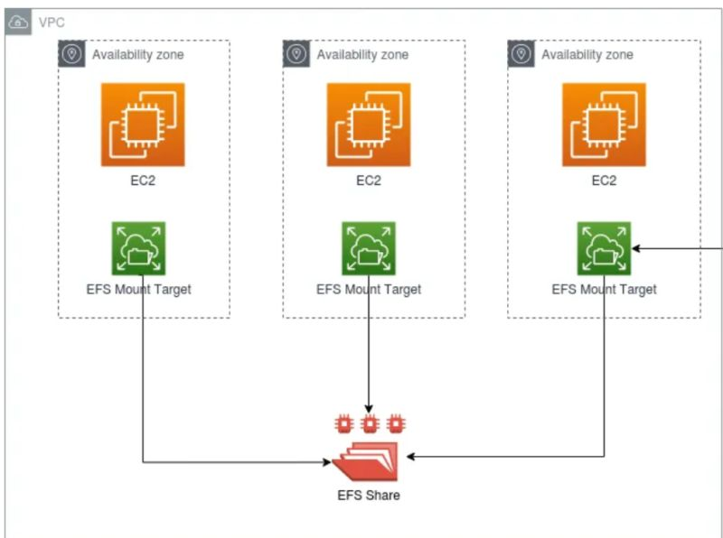
EFS Mount to EC2

Slide 19
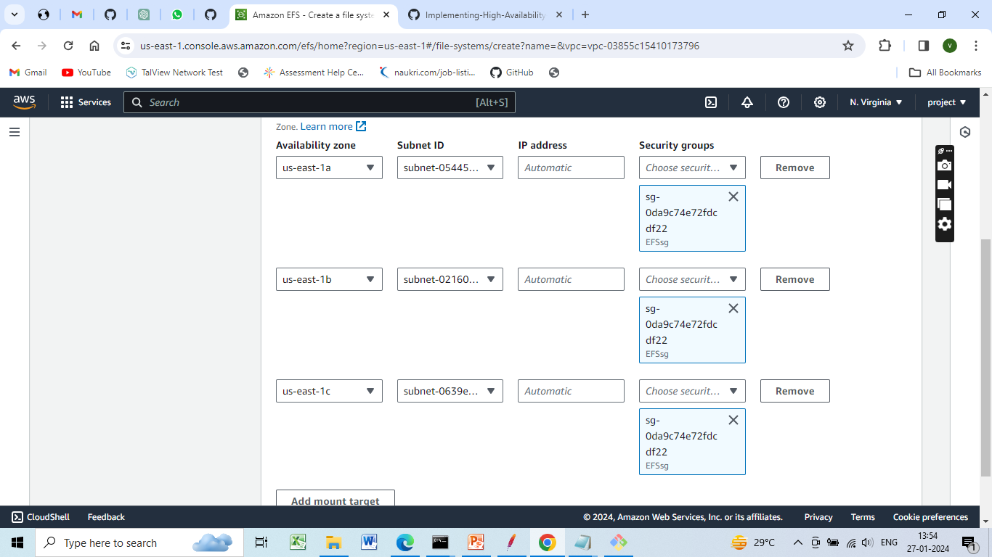

Slide 20
Steps to Mount EFS to EC2
1 Create EC2 Instance with port 22 opened
2 Create Security Group for EFS Inbound type NFS allow source - EC2 attached Security group
3 Create EFS
4 Attach EFS Security group in EFS file system
5 Click "Attach" button in EFS to get the mount point command

Slide 21
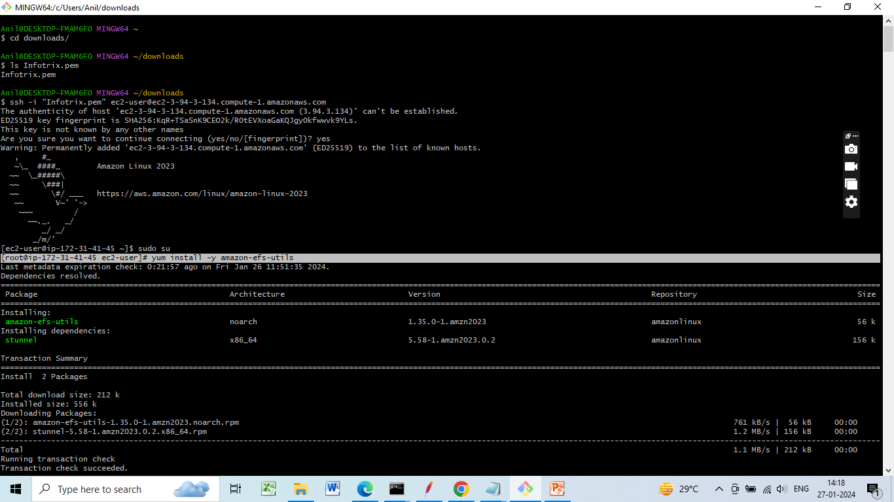
6 Installation of efs utility yum install -y amazon-efs-utils

Slide 22
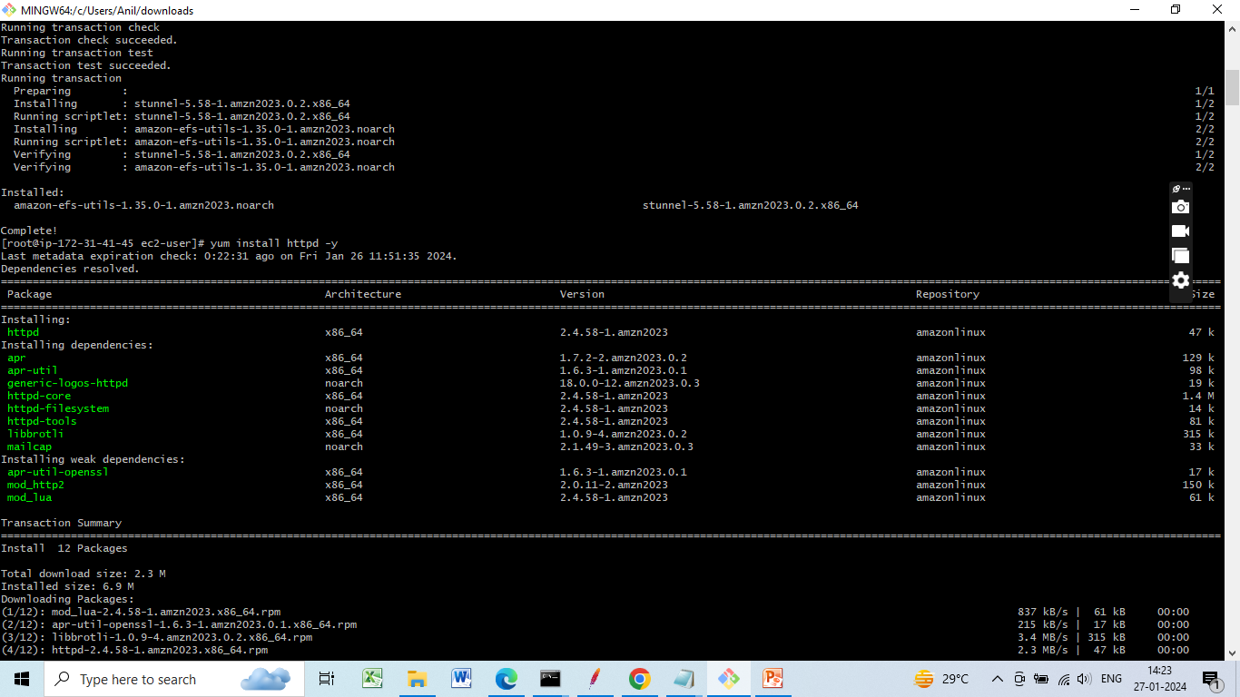
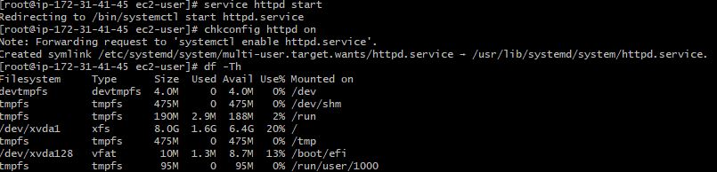
7 yum install httpd -y
8, service httpd start
chkconfig httpd on
df –Th

Slide 23
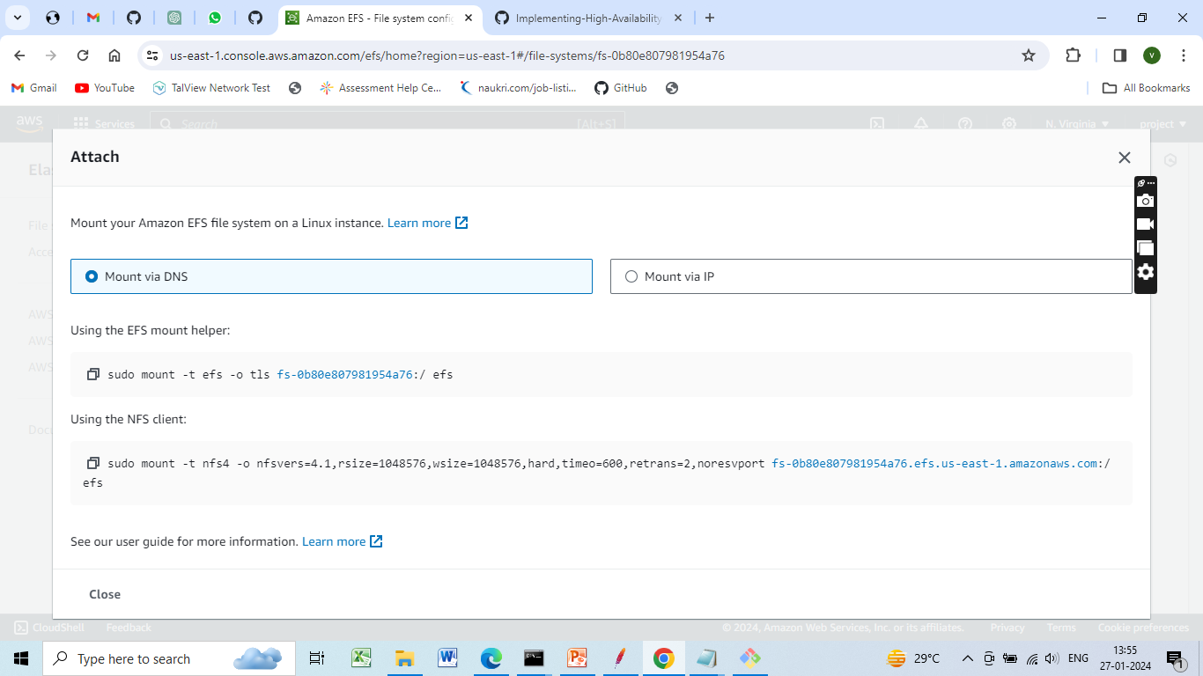
EFS file system, mount it to EC2 instances

Slide 24
9, sudo mount -t nfs4 -o nfsvers=4.1,rsize=1048576,wsize=1048576,hard,timeo=600,retrans=2,noresvport fs-0b80e807981954a76.efs.us-east-1.amazonaws.com:/ /var/www/html/

Slide 25
10 cd /var/www/html/
11 vi index.html
<!DOCTYPE html>
<html>
<body>
<h1>HTML Links</h1>
<p><ahref="https://studio.openweaver.com/apps/preview/viminfotrix/Infotrix%20project/faqanswerpage">Visit Infotrix project!</a></p>
</body>
</html>

Slide 26
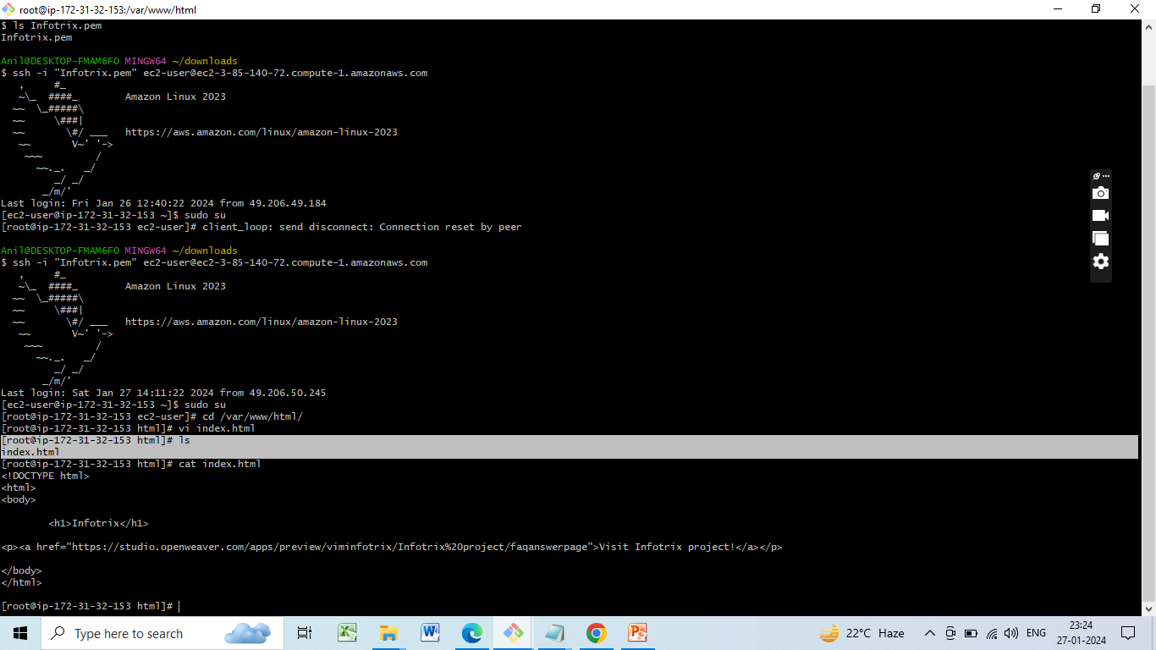
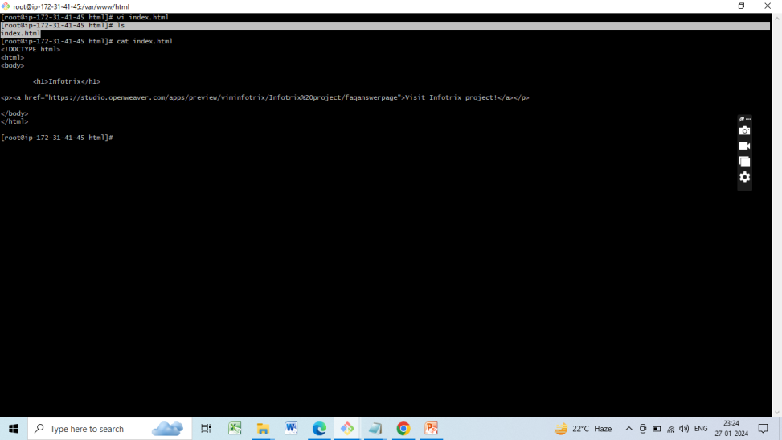
File shared between Multiple Instances
Instance 1
Instance 2

Slide 27
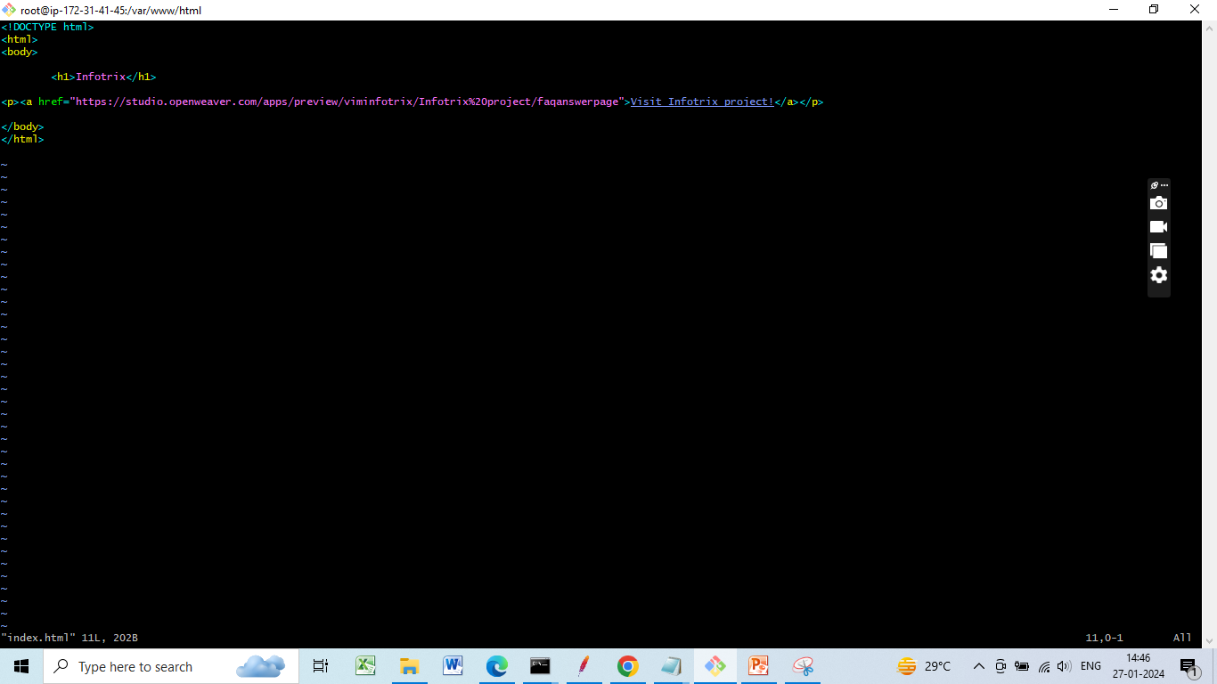
vi index.html

Slide 28
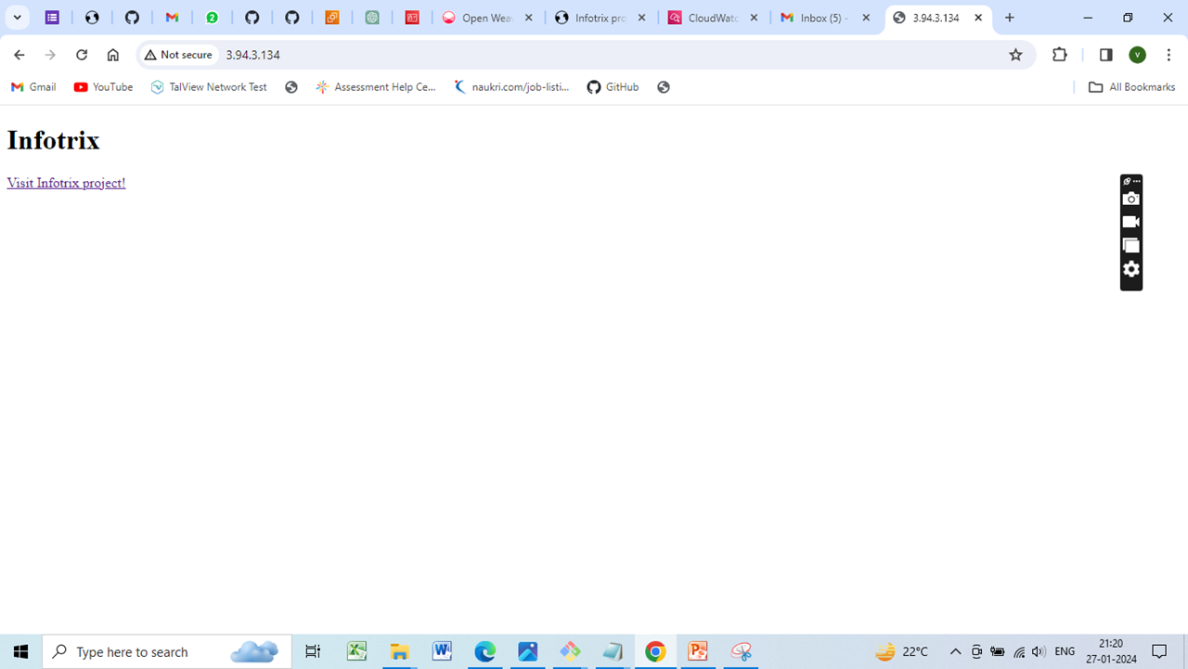
checking the index file content through EC2 instance Public Url

Slide 29
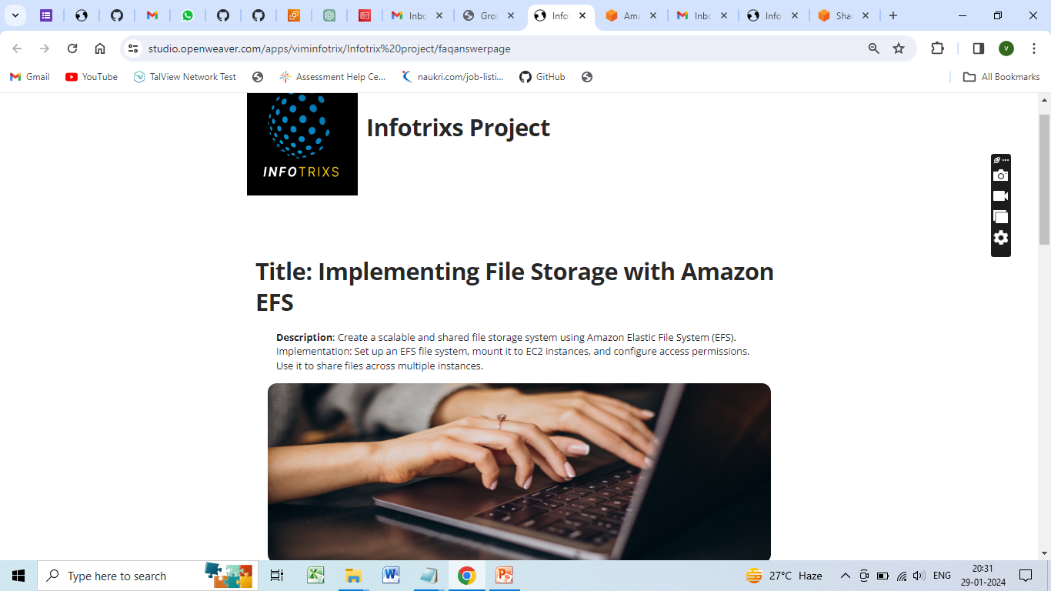
Index.html- Home page

Slide 30
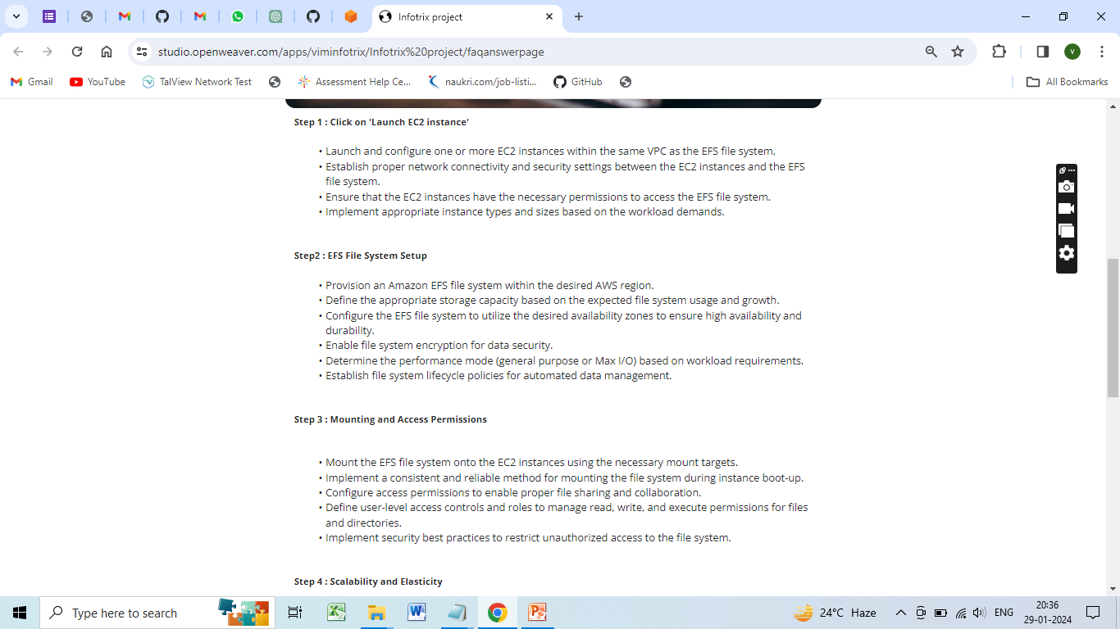

Slide 31
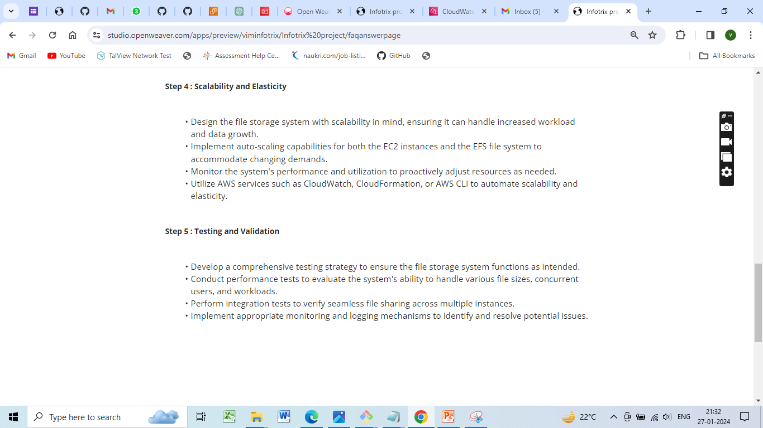

Slide 32
Configure access permissions user-level access controls and roles to manage read, write, and execute permissions for files and directories.
sudo chmod 777 /mnt/efs

Slide 33
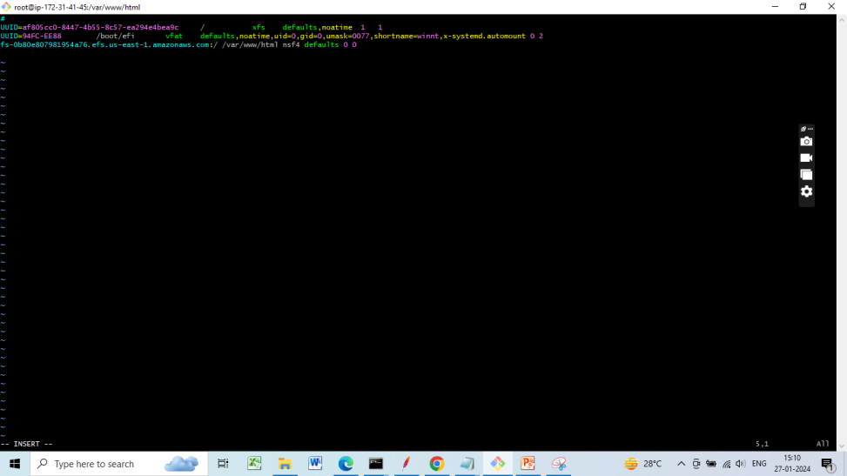
Add mount to fstab to mount at boot time

Slide 34
Scalability and Elasticity
Design the file storage system with scalability in mind, ensuring it can handle increased workload and data growth.
Implement auto-scaling capabilities for both the EC2 instances and the EFS file system to accommodate changing demands.
Monitor the system's performance and utilization to proactively adjust resources as needed.
Utilize AWS services such as CloudWatch, CloudFormation, or AWS CLI to automate scalability and elasticity.

Slide 35
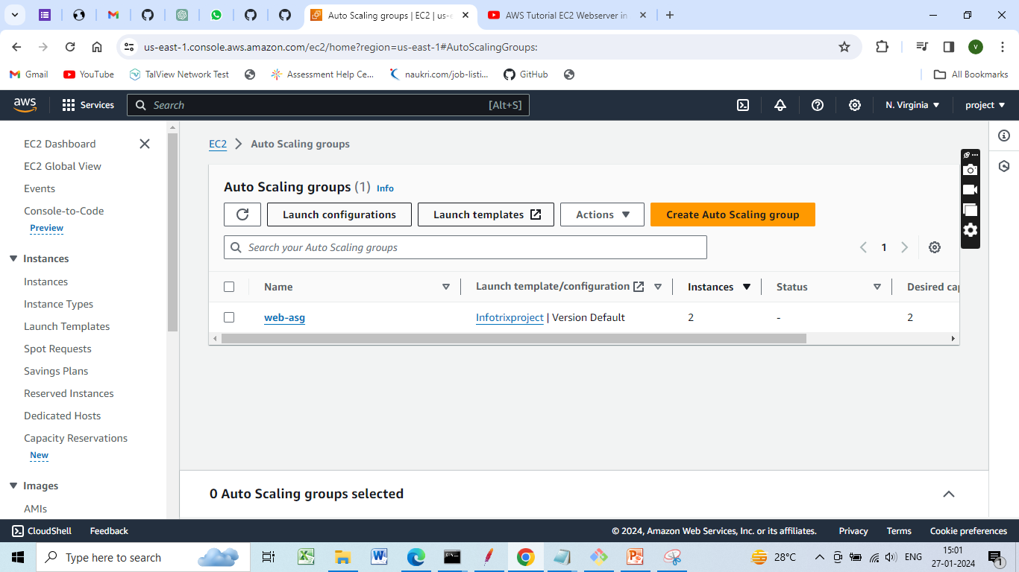
Implement auto-scaling capabilities for both the EC2 instances

Slide 36
Creating Autoscaling Group
Create an Autoscaling Group and associate it with the EC2 instances.
Configure launch configurations with details like the Amazon Machine
Image (AMI), instance type, and user data script.
Define scaling policies based on CPU utilization.
For example,
This example sets an alarm that triggers when the average CPU utilization is greater than 80% for two consecutive 5-minute periods.

Slide 37
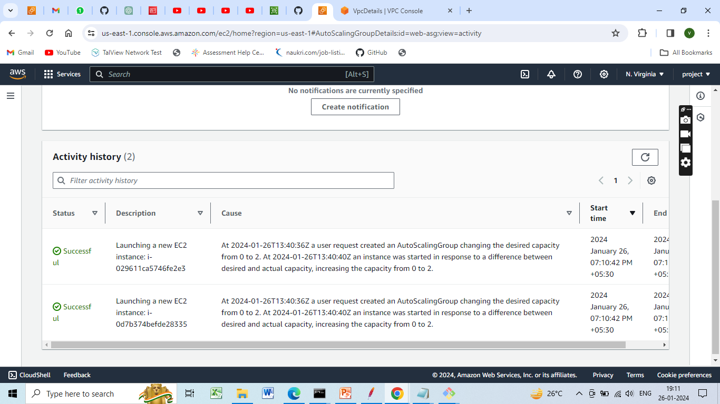

Slide 38
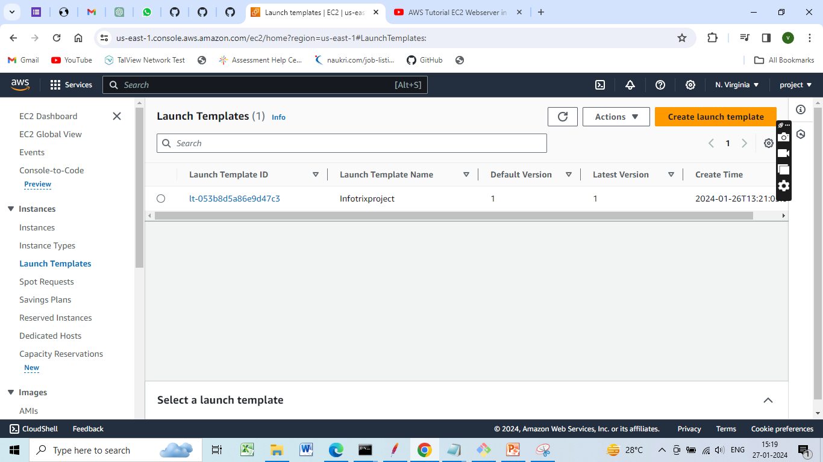
Create launch template

Slide 39
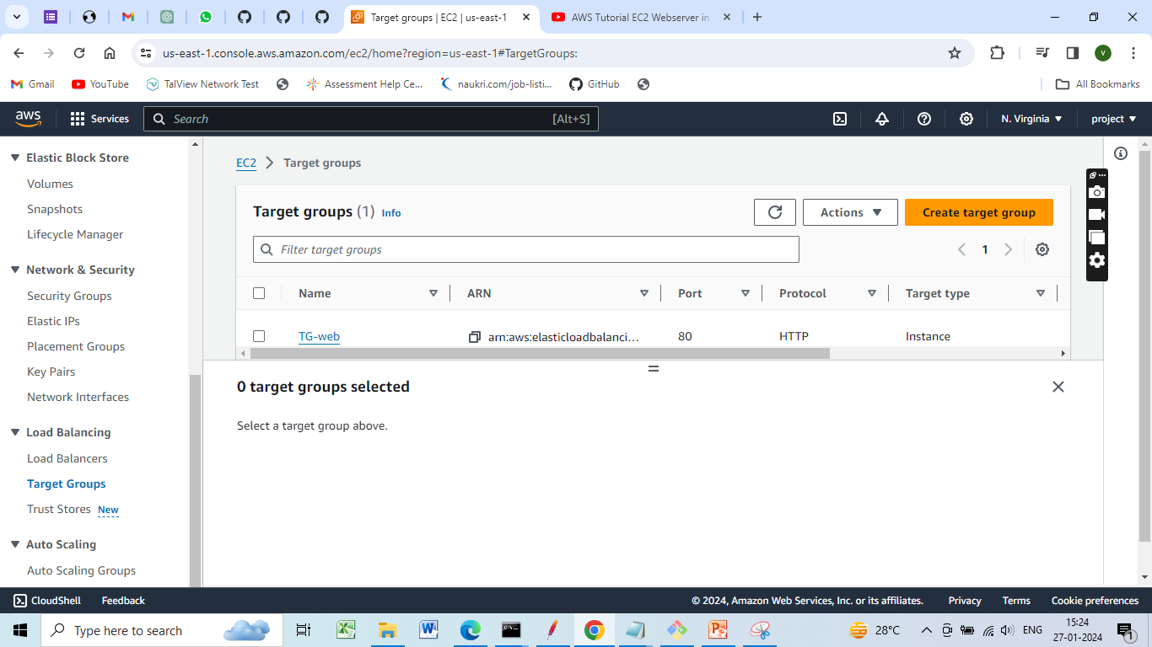
Create Target groups

Slide 40
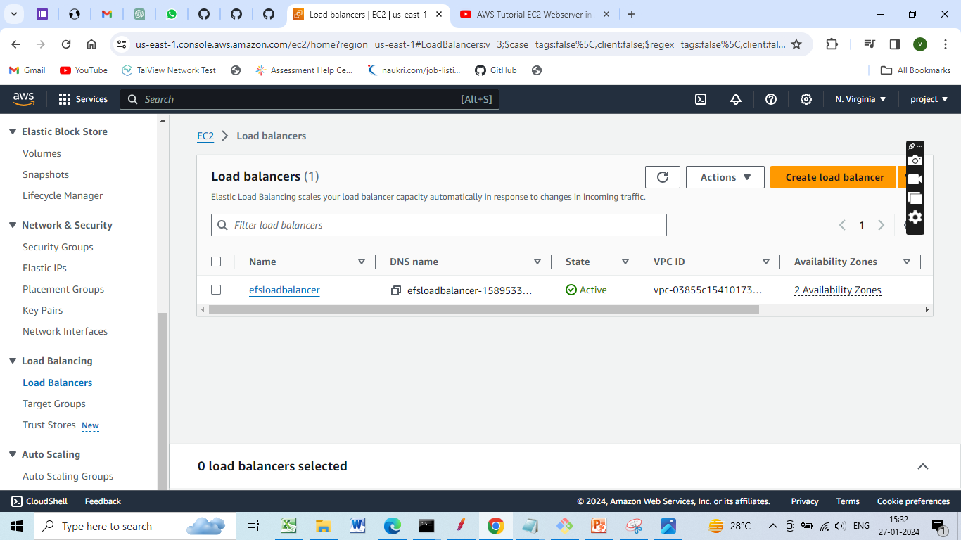
Creating Load Balancer

Slide 41
Creating Load Balancer
Create an Elastic Load Balancer (Application Load Balancer or Network Load Balancer).
Configure listeners and target groups to route traffic to instances in the Autoscaling Group

Slide 42
Logging and Monitoring
Enable logging on the load balancer and instances.
Set up CloudWatch Alarms to trigger based on CPU usage and other relevant metrics.
Monitor logs and alarms to troubleshoot any issues

Slide 43
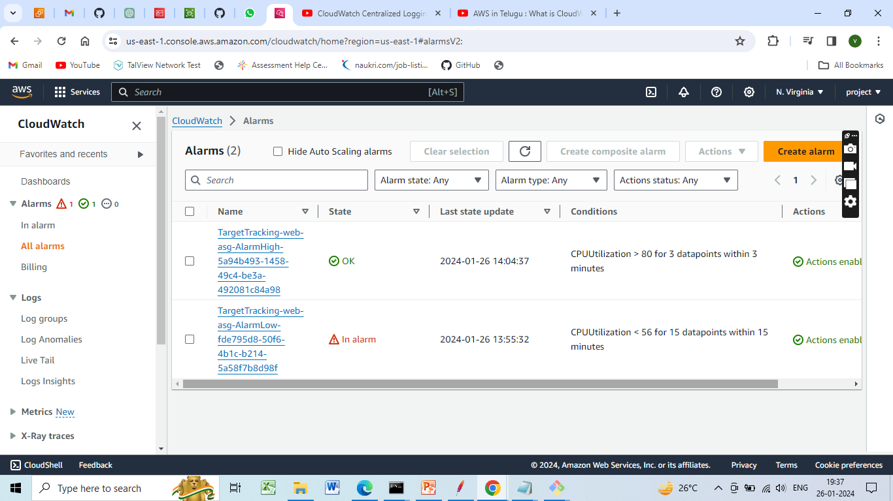
AWS services such as CloudWatch to automate scalability and elasticity
1,Set Up Cloud Watch Alarms

Slide 44
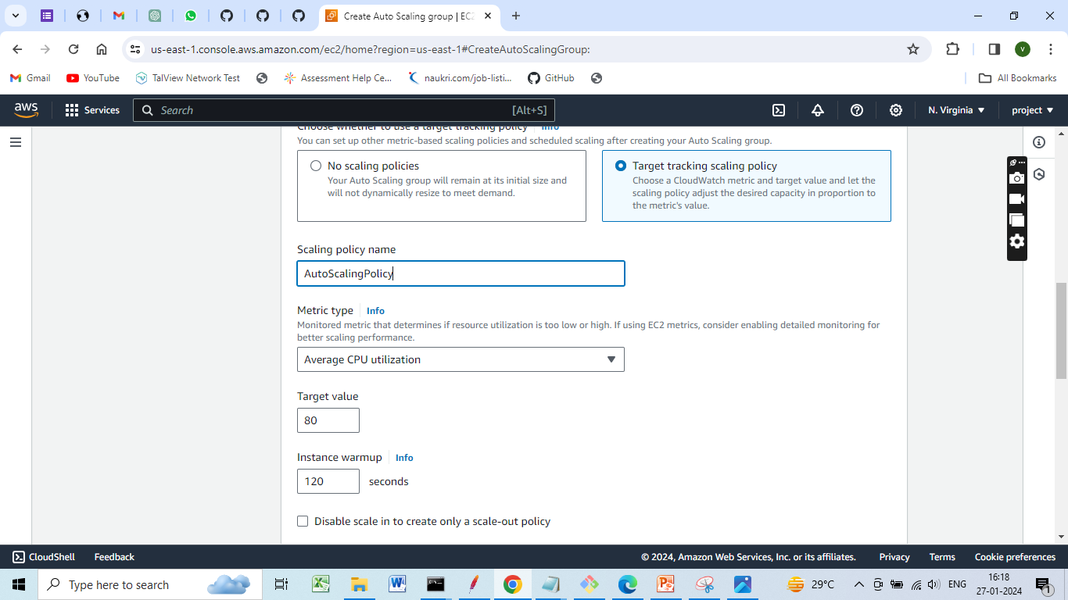
Define Auto Scaling Policies

Slide 45
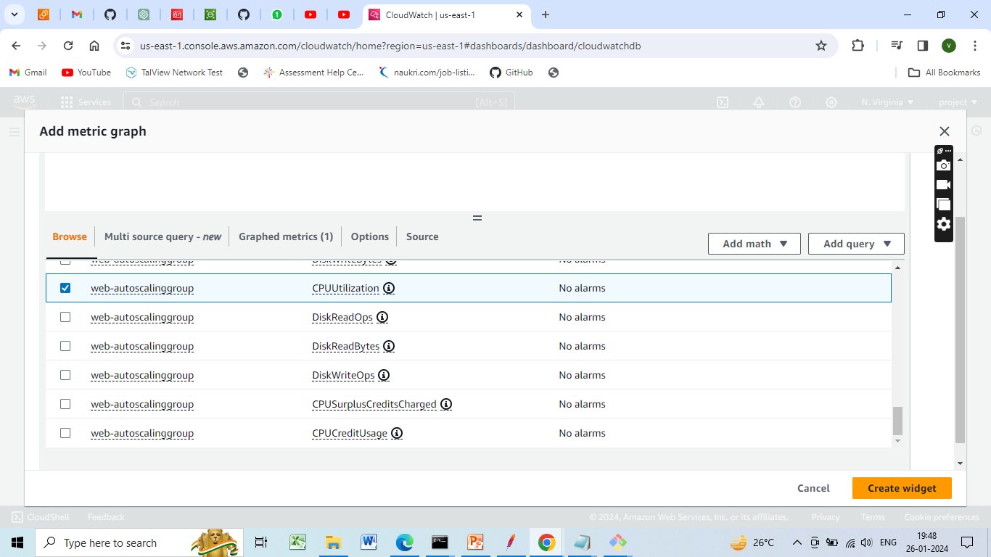
Cloud Watch metrics

Slide 46
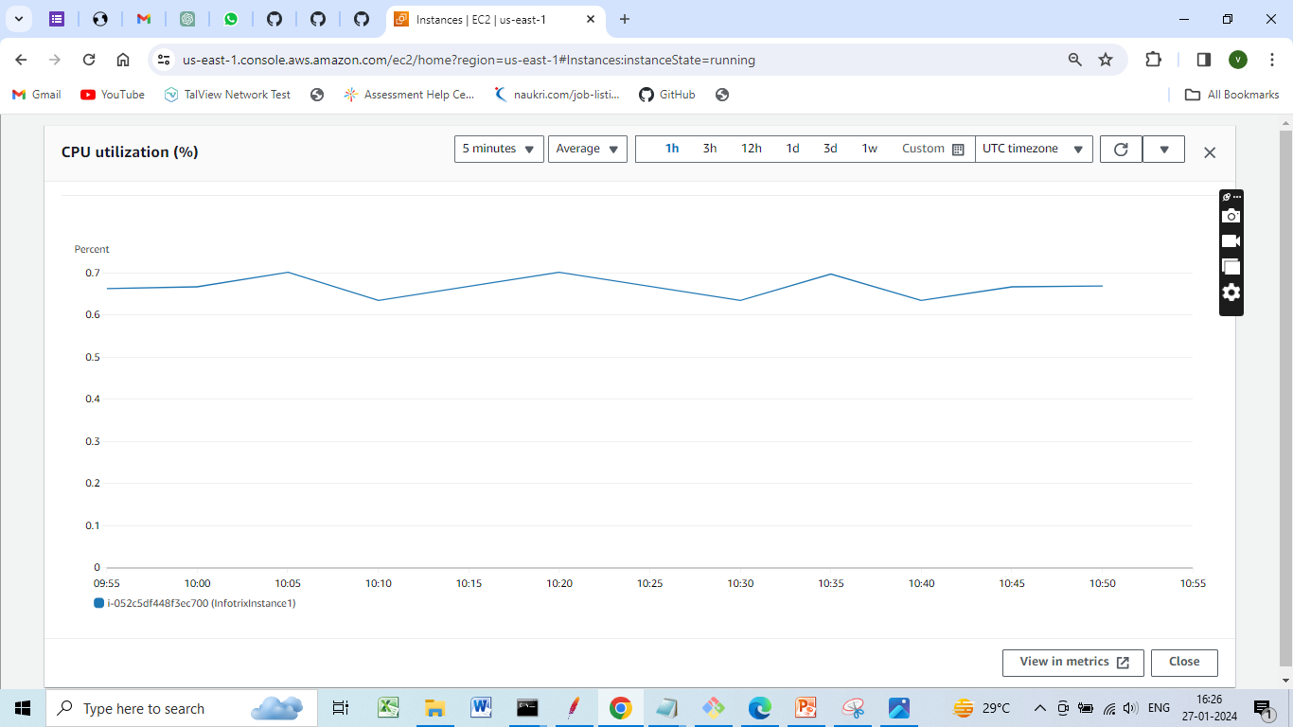
Graph Showing CPU Utilization

Slide 47
Testing and Validation
Develop a comprehensive testing strategy to ensure the file storage system functions as intended.
Conduct performance tests to evaluate the system's ability to handle various file sizes, concurrent users, and workloads.
Perform integration tests to verify seamless file sharing across multiple instances.
Implement appropriate monitoring and logging mechanisms to identify and resolve potential issues.

Slide 48
comprehensive testing strategy
Performance testing
Performance Testing is a process of testing a software application under a specific workload
Testing is performed to test the speed reliability response time and resource usage
The focus is on identifying and eliminating any resistances in the software application

Slide 49

Tool used for performance testing
Jmeter
The Apache JMeter is an open-source
purely java based software
It is used to test load testing functional
behaviour and measuring performance
Initially, Jmeter was developed to test applications but now has expanded to other test functions.

Slide 50
Installing jmeter tool
Prerequisites to Install Jmeter
Since Jmeter is purely java –based, having Java on the desktop is a must.
Jmeter is compatible with Operating Systems like:
Linux
Windows
Mac OS
Ubuntu

Slide 51
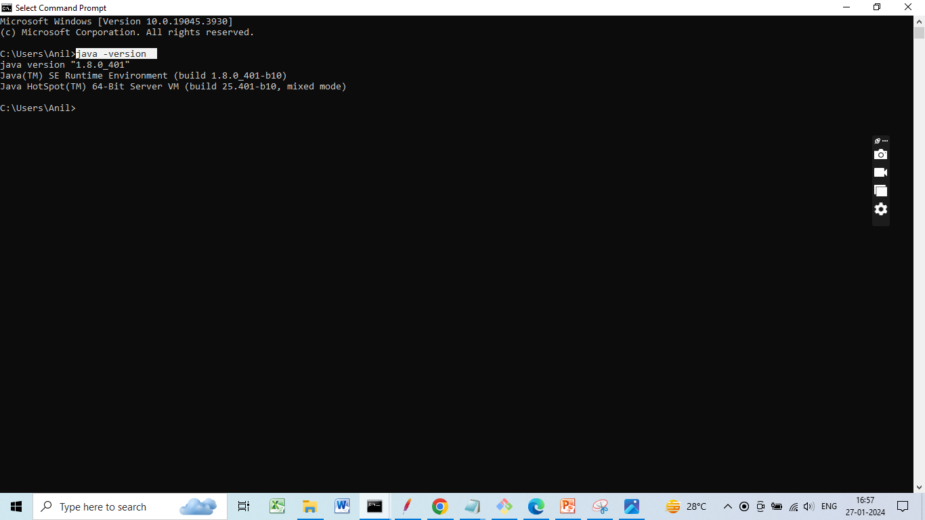
1.Check if Java Is Installed
Open the command prompt
Put the command java –version

Slide 52
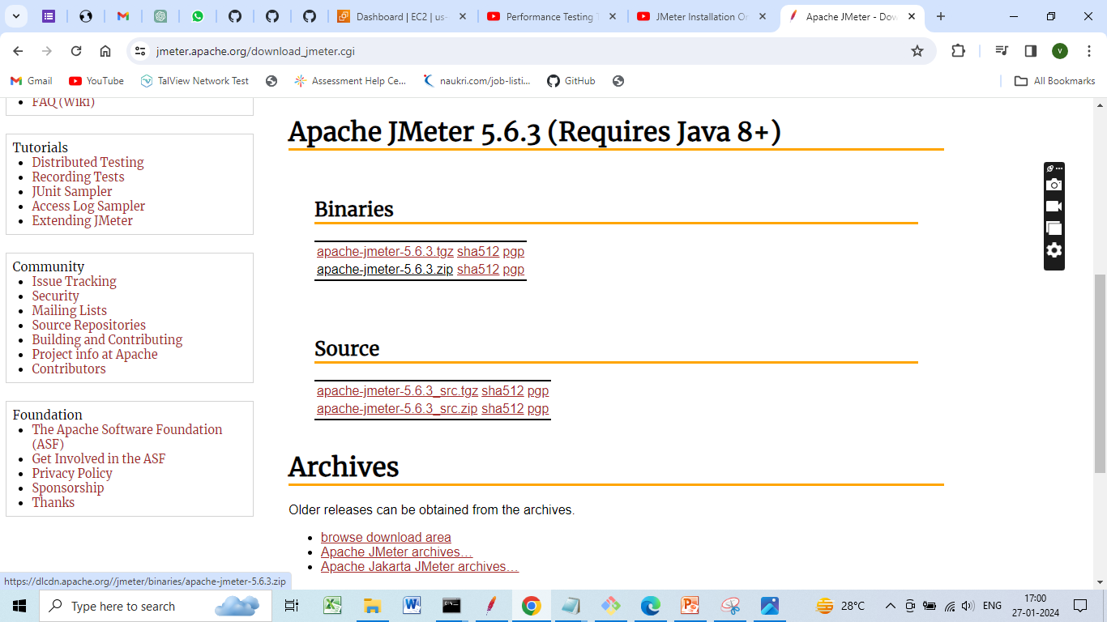
2.Download Jmeter
To download JMeter go to the Apache JMeter website
https://jmeter.apache.org/download_jmeter.cgi
On the website go to the binaries section and download the zip file
Wait for the zip folder to be downloaded

Slide 53
3. Install JMeter
Once the zip folder is downloaded, go to the folder location, and then extract the zip folder
Once the folder is extracted go inside that folder and then go inside the bin folder here
In the bin folder open the jmeter.bat file

Slide 54
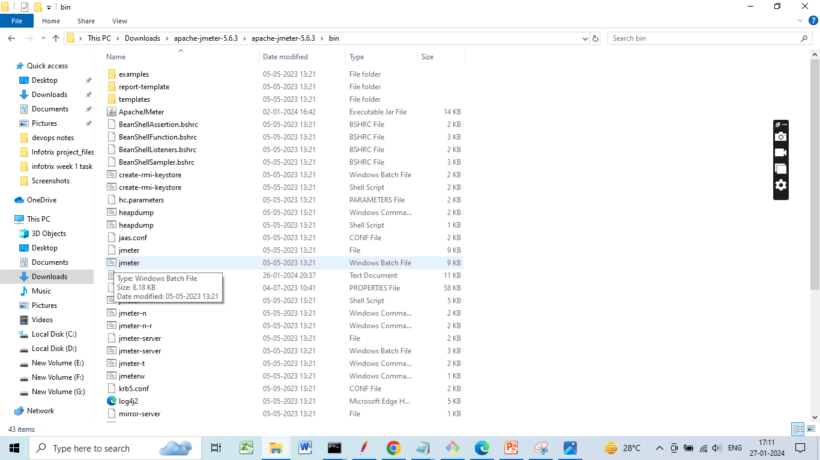
JMeter.batch file

Slide 55
4. Create the First test plan
The first step in creating the test plan is
Adding a Thread Group
Open the JMeter window
The window is divided into two parts. The left side has all the added elements, while the right side has all the elements' configurations.
Rename the test plan and save it
Now, rename it as the FirstJMeter.
Right-click on the test plan.
Go to add -> Threads (Users) -> Thread Group

Slide 56
Now, once you click on the Thread Group, there are three things on the screen that are important concerning the load test:
The number of threads (users):
This is the number of threads or users JMeter will simulate.
Let's make it 100.
Ramp-Up Period (in seconds):
This is the time that JMeter takes before starting the thread over.
Let’s keep this as 12.
Loop Count:
This is the number of times the test will be executed.
And this one, let's leave it to be 10

Slide 57
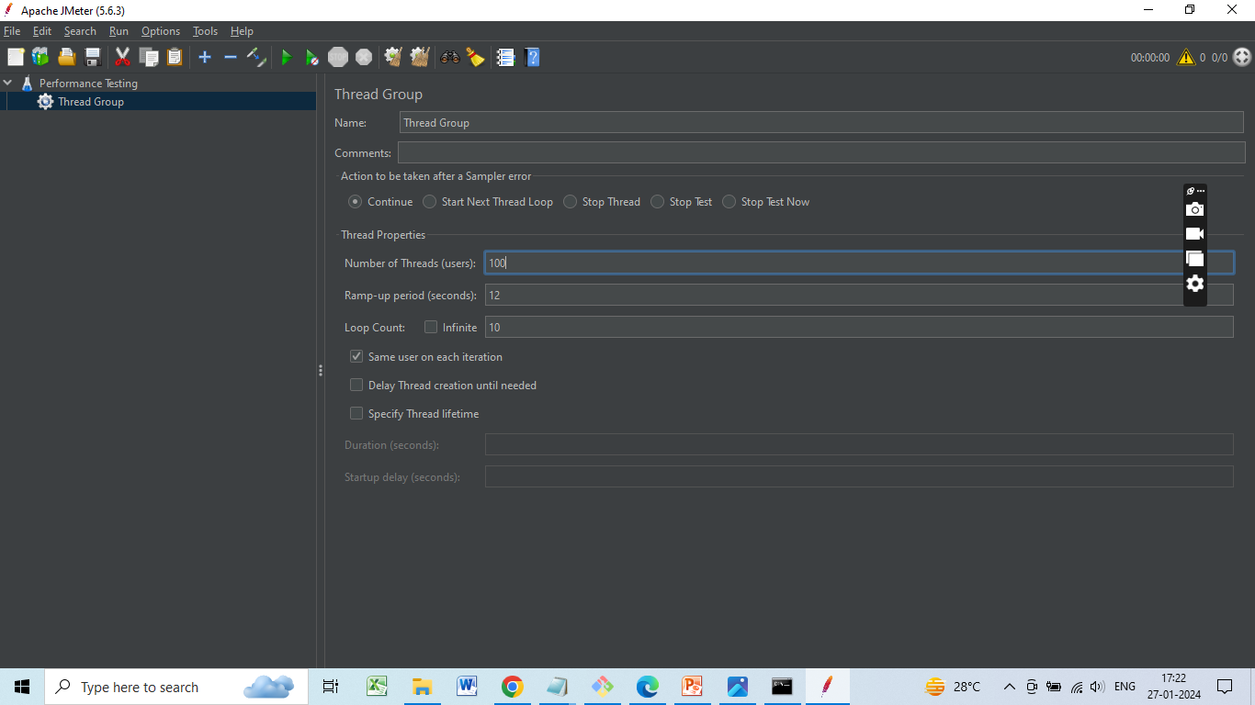

Slide 58
Add an HTTP Request
Right-click on FirstJMeter and again go to add
In the drop-down select samplers
These are all the types of requests that JMeter can work on.
For now, choose the simplest of them all, the HTTP request.
Here you will have to give the address to some home pages or websites.

Slide 59
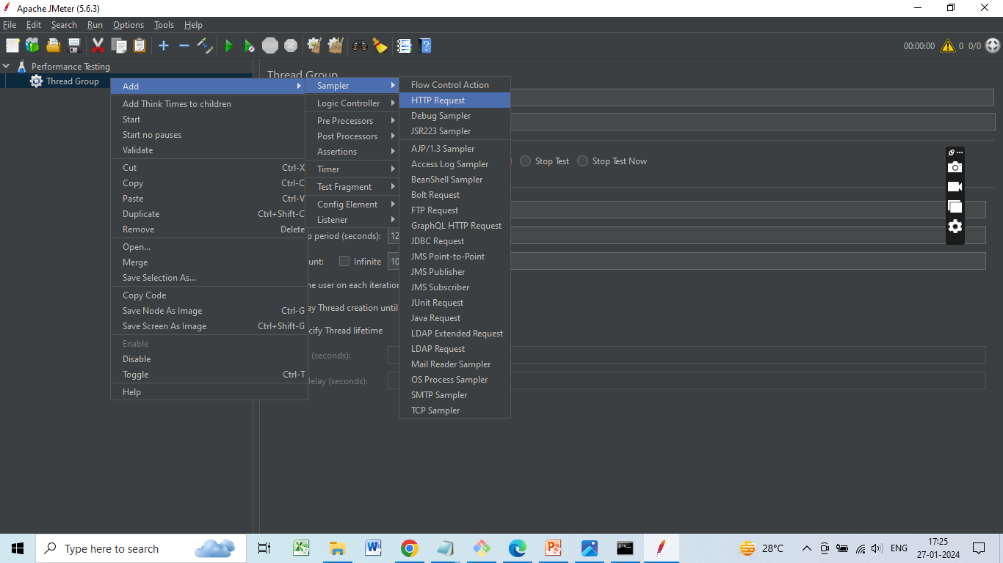

Slide 60
Now, rename it to be HomePages.
Here, in the Server Name or IP box, you have to give the server name or the IP.
Copy the IP
Come back to the JMeter window and paste it into the Server Name box
Don't give HTTP or HTTPS since these are protocols that will come in the other box. They will be automatically taken in the HTTP request case.
Then in the path dialog box, leave a forward slash there.

Slide 61
Add Listeners
To determine what the results of the test will be, you need to add some more test elements.
Right-click on Performance Testing
Go to listener options
For now, select the two of these:
View results in table
View results tree

Slide 62
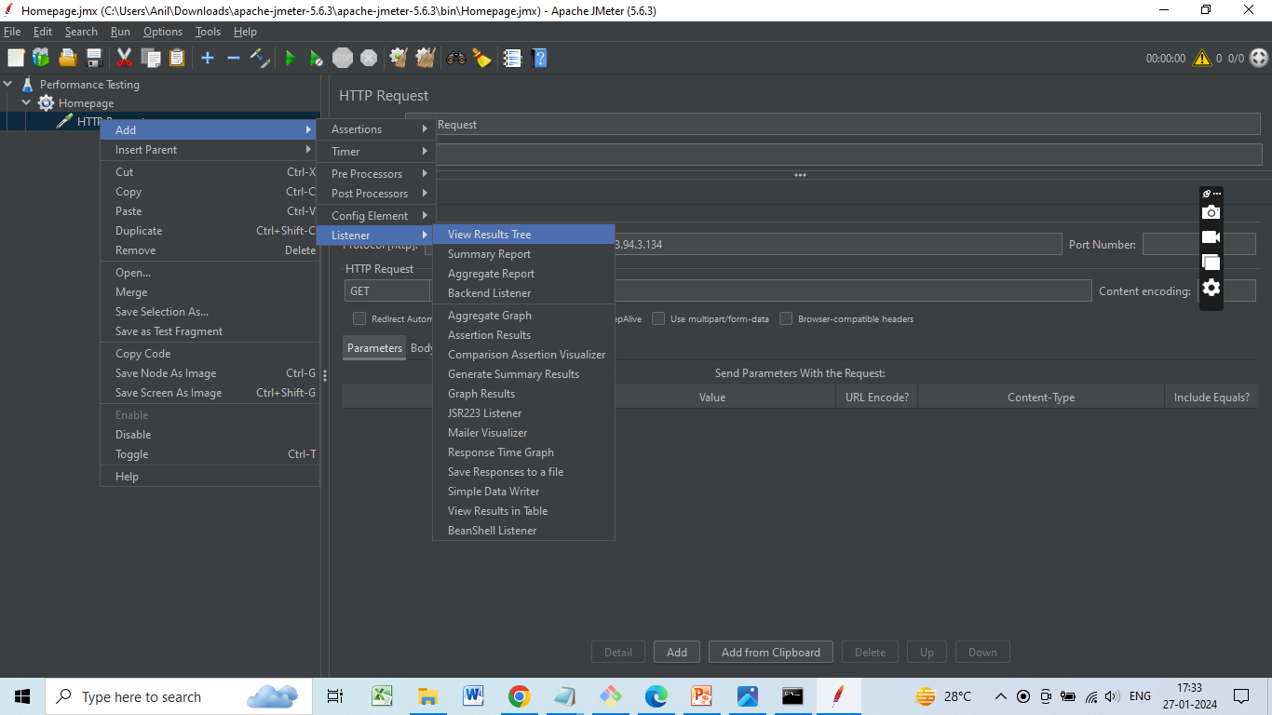

Slide 63
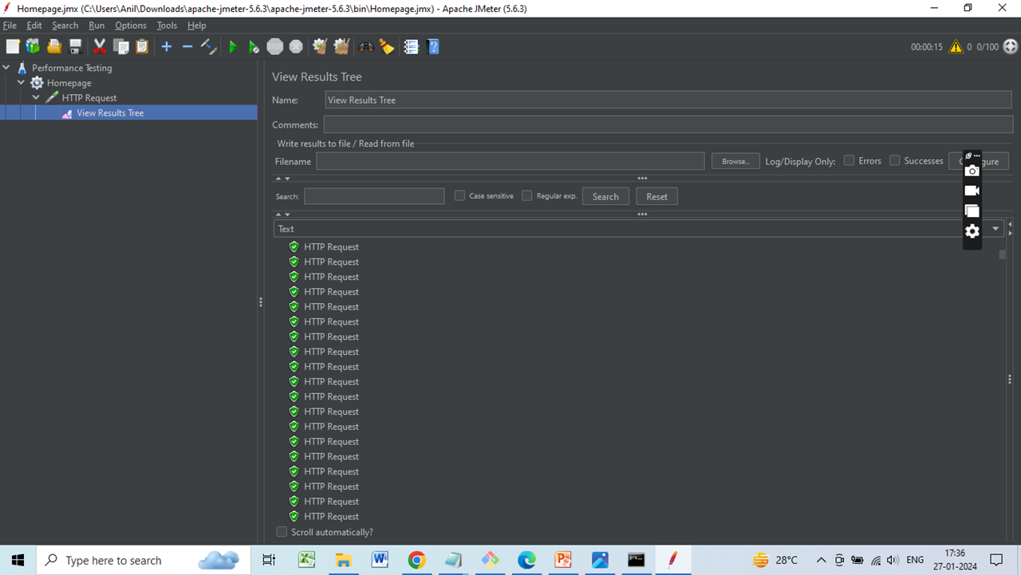
View results in tree

Slide 64
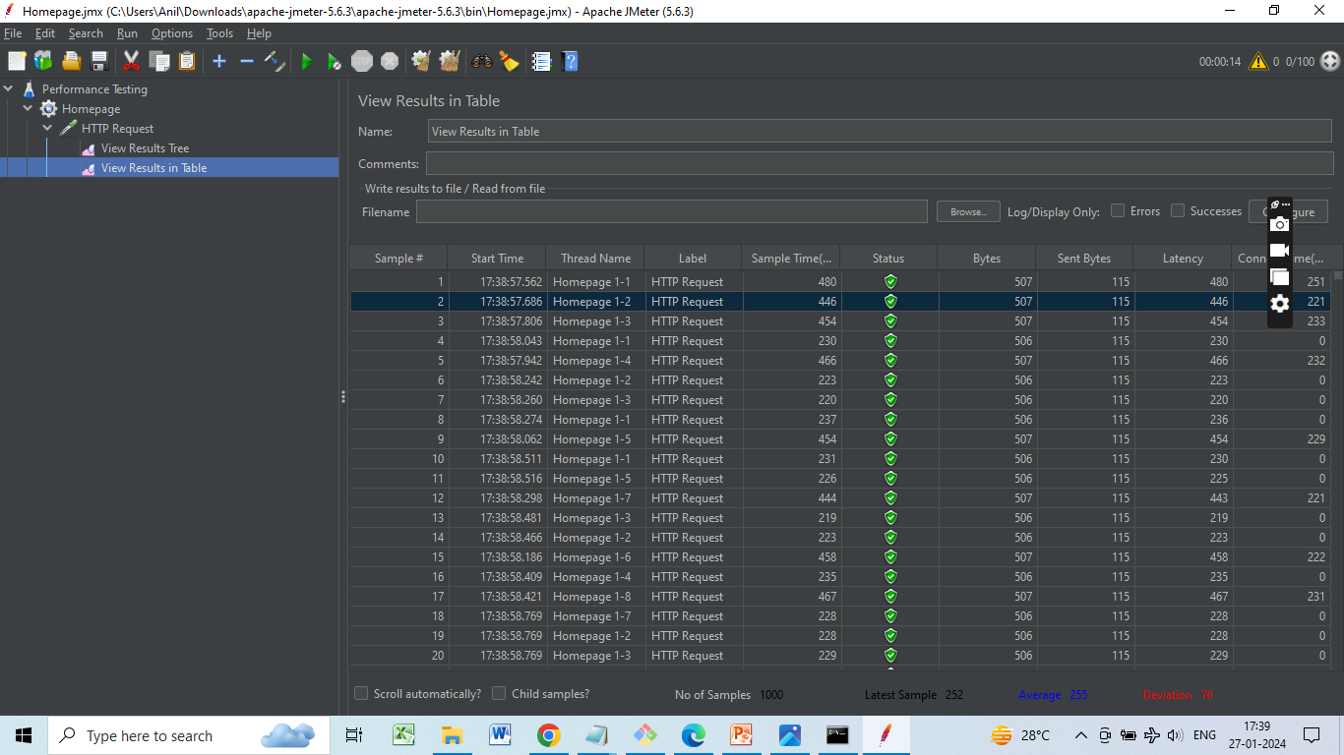
View results in table

Slide 65
Perform integration tests to verify seamless file sharing across multiple instances
Integration Test :
1. Concurrent File Writes:
Instance 1
echo "Content from Instance 1" > /mnt/efs/sharedfile.txt
Instance 2
echo "Content from Instance 2" >/mnt/efs/sharedfile.txt
2.Concurrent File Reads:
cat /mnt/efs/sharedfile.txt

Slide 66
3.File Locking:
Implement file locking scenarios to test how instances handle shared resources.
Instance 1
flock /mnt/efs/sharedfile.txt -c 'echo "Content from Instance 1" > /mnt/efs/sharedfile.txt'
Instance 2
flock /mnt/efs/sharedfile.txt -c 'echo "Content from Instance 2" > /mnt/efs/sharedfile.txt'

Slide 67
4. Concurrent File Deletions:
rm /mnt/efs/sharedfile.txt
5. Network Interruption
Instance 1
sudo iptables -A INPUT -p tcp --dport 2049 -j DROP
Instance 2
sudo iptables -A INPUT -p tcp --dport 2049 -j DROP

Slide 68
CloudWatch for Monitoring and Logging
Configure EC2 to send application logs to Cloudwatch log groups
Create a new IAM role, select EC2 Service and this policy - CloudWatchAgentServerPolicy
Create a EC2 instance, allow ssh port and attach the above IAM role to the instance.
Install java
sudo yum -y install java-1.8.0

Slide 69
Download the spring application jar file
sudo wget https://raw.githubusercontent.com/gaurav157243/aws-project/master/springboot-backend/springboot-backend.jar
Start the application in background and redirect the output to a file
sudo nohup java -jar springboot-backend.jar > /tmp/myapp.log 2> /tmp/myapp.log &
Install the cloudwatch agent using the following command:
sudo yum install amazon-cloudwatch-agent

Slide 70
Configure the cloudwatch agent using the following command. Specify the location of the myapp.log (/tmp/myapp.log) file during configuration.
sudo /opt/aws/amazon-cloudwatch-agent/bin/amazon-cloudwatch-agent-config-wizard
Starting the cloudwatch agent; use the config file returned from the above command:
sudo /opt/aws/amazon-cloudwatch-agent/bin/amazon-cloudwatch-agent-ctl -a fetch-config -m ec2 -s -c file:/opt/aws/amazon-cloudwatch-agent/bin/config.json
Check status:
sudo /opt/aws/amazon-cloudwatch-agent/bin/amazon-cloudwatch-agent-ctl -m ec2 -a status

Slide 71
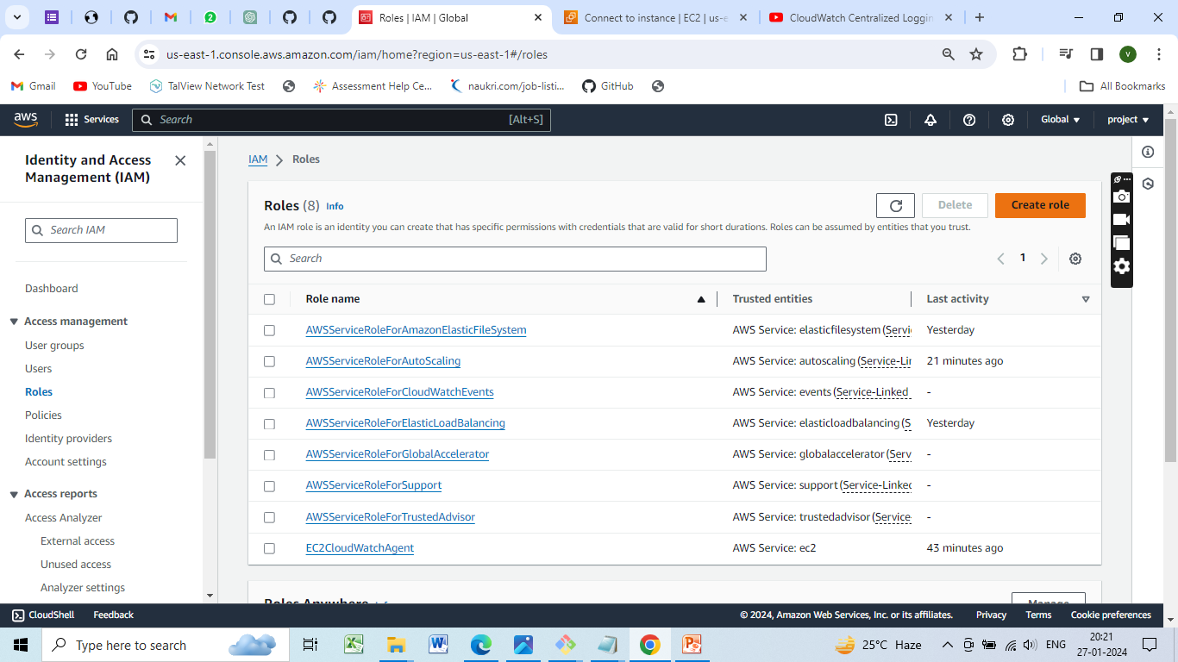
Create a IAM Role

Slide 72
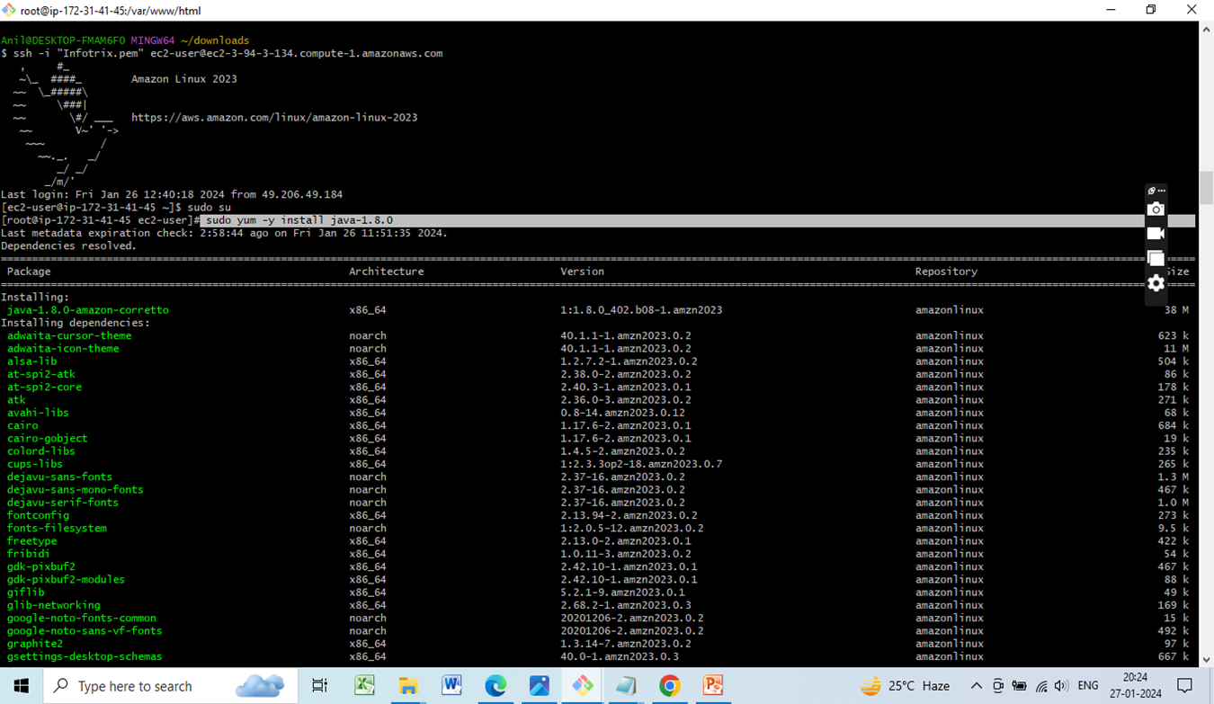
Install java sudo yum -y install java-1.8.0

Slide 73
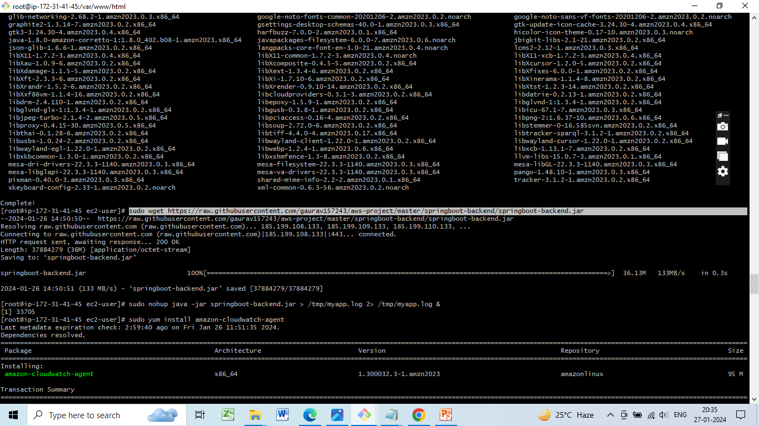
Download the spring application jar file

Slide 74
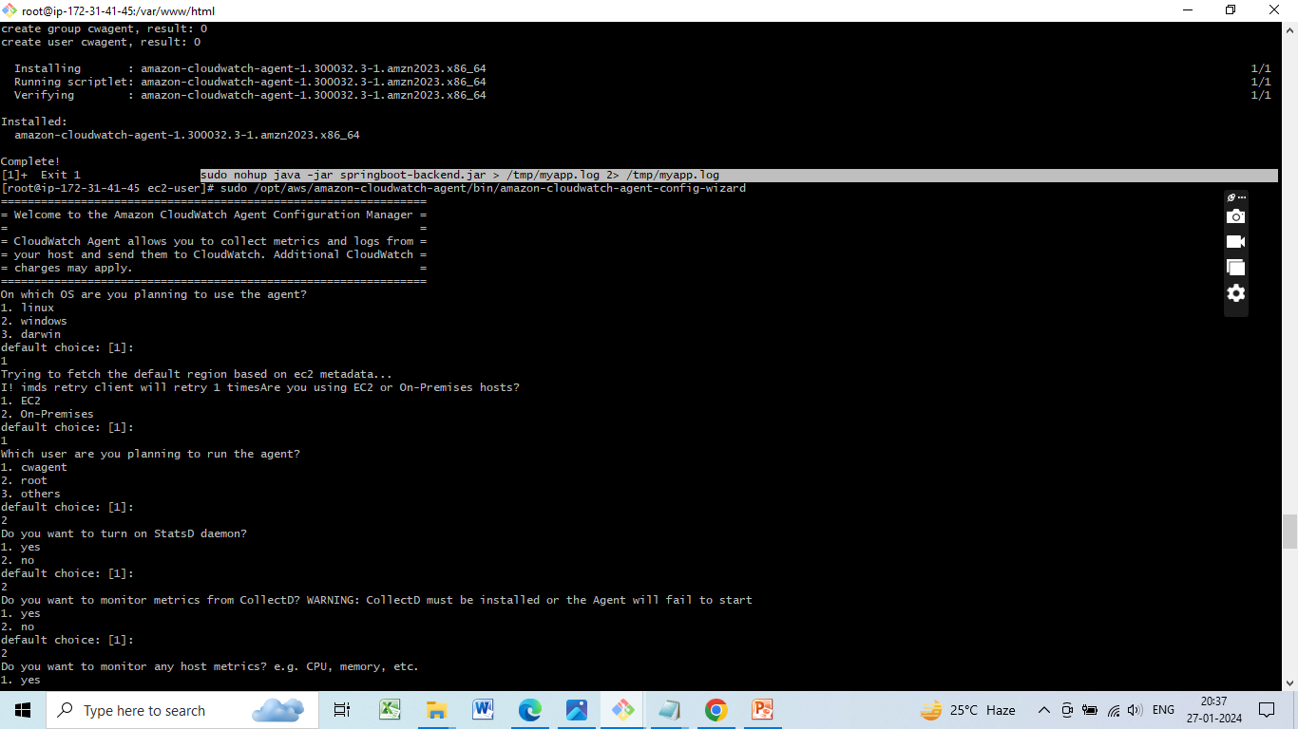
Start the application in background and redirect the output to a file

Slide 75
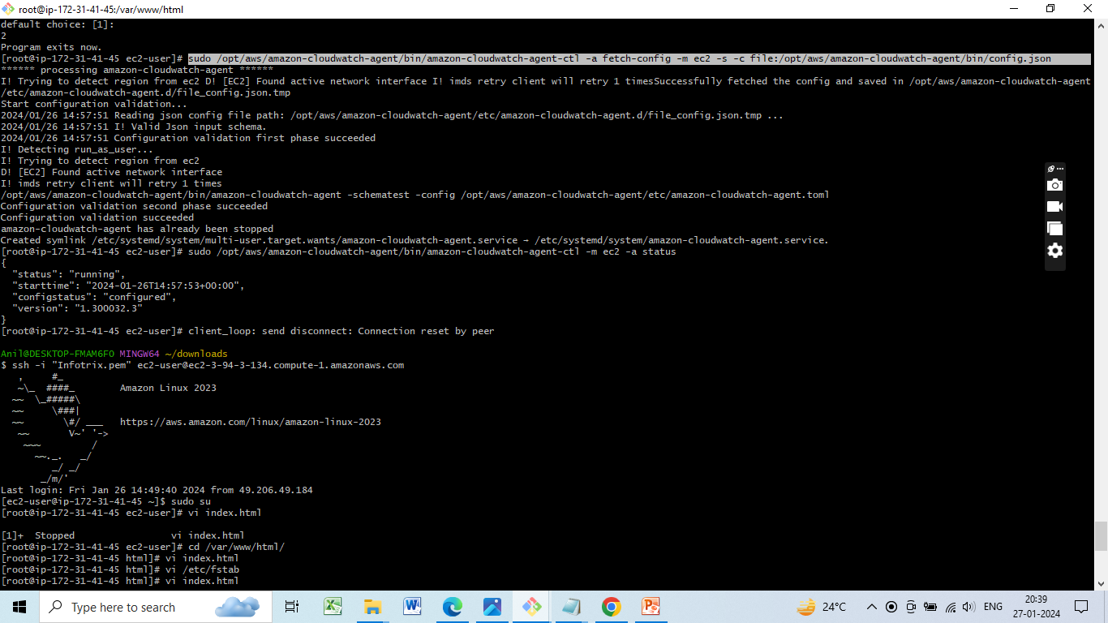
Configure the cloudwatch agent using the following command
sudo /opt/aws/amazon-cloudwatch-agent/bin/amazon-cloudwatch-agent-config-wizard

Slide 76
Starting the cloudwatch agent
sudo /opt/aws/amazon-cloudwatch-agent/bin/amazon-cloudwatch-agent-ctl -a fetch-config -m ec2 -s -c file:/opt/aws/amazon-cloudwatch-agent/bin/config.json

Slide 77
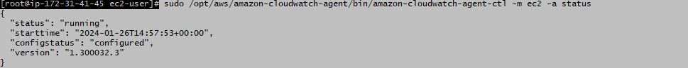
Check status
sudo /opt/aws/amazon-cloudwatch-agent/bin/amazon-cloudwatch-agent-ctl -m ec2 -a status

Slide 78
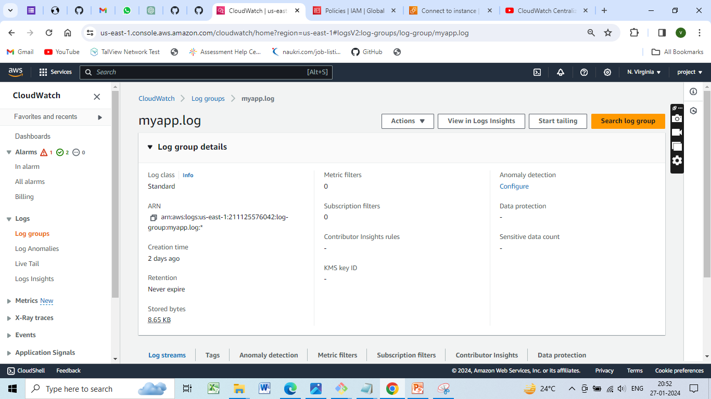
Check Cloudwatch
Log groups and search for myapp.log and you will see your applications log.

Slide 79
Log Issues
Log File Permission Issue
Error:
PermissionError: [Errno 13] Permission denied: 'your_log_file.log'
Resolution:
Ensure that the process running the script has write permissions for the log file.
Correct file permissions or use a directory where the process has write access.

Slide 80
Conclusion
Created a scalable and shared file storage system using Amazon Elastic File System (EFS). Implemented Setting up an EFS file system, and mount it to EC2 instances, and configured access permissions and shared files across multiple instances.

Slide 81
Resources and References:
Amazon Elastic File System (EFS) Documentation: https://aws.amazon.com/efs/
Amazon EC2 Documentation: https://aws.amazon.com/ec2/
AWS Identity and Access Management (IAM) Documentation: https://aws.amazon.com/iam/
Amazon CloudWatch Documentation: https://aws.amazon.com/cloudwatch/

Slide 82


